Slide 1
VII.3 SPM

Slide 2
CRITICAL PATH METHOD (CPM)
It is project schedule modeling technique.
A network diagram has many paths originating from one point and ending at another point. Every path has a duration and the one with the longest duration is the critical path.
You can define a critical path as:
The longest path in the network diagram, or
The shortest duration to complete the project.

Slide 3
Contd..
For example, let’s say you have a project to construct three buildings. The first is the largest, the second is medium-sized, and the third is the smallest.
You develop the network diagram which comprises three paths; each path represents each building.
You calculate the duration for each path. For the first building, the duration is 31 months, the second will take 18 months, and the third will require 13 months.
You can see that the first path is for the largest building, the second path is for the medium-sized one, and the third path is for the building.

Slide 4
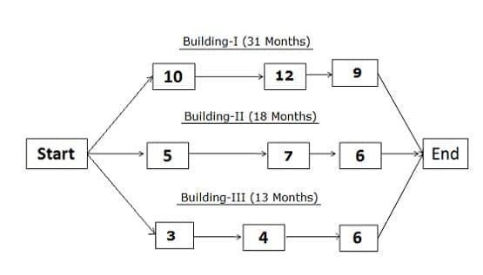
Network Diagram

Slide 5
CPM Contd..
You can define the critical path as the sequence of activities from start to end, and it has the longest duration among all paths in a network diagram.
In ideal conditions, a network diagram should have one critical path. If it has more than one critical path, you will be in a difficult situation because you will have to manage more than one critical path.
The critical path has the longest duration, and it is the project’s duration. Activities on the critical path have no float; therefore, you must ensure that critical activities complete on time. Any delay in a critical activity will delay the project.

Slide 6
Procedure for Finding the Critical Path in a Network Diagram
You can use the following steps to find a critical path in a network diagram:
Draw the network diagram.
Identify all paths in the network diagram.
Find the duration of each path.
The path with the largest duration is the critical path.

Slide 7
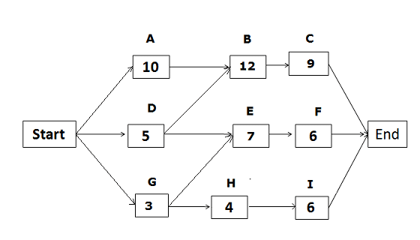
Example
Based on the network diagram below, identify the total paths, critical path, and float/slack for each path.

Slide 8
Contd..
The above network diagram has five paths. The paths and their durations are as follows:
Start -> A -> B -> C-> End {duration: 31 days.}
Start ->D -> E ->F -> End {duration: 18 days.}
Start -> D -> B -> C -> End {duration: 26 days.}
Start -> G ->H ->I -> End {duration: 13 days.}
Start -> G -> E ->F -> End {duration: 16 days.}

Slide 9
Contd..
Since the duration of the first path is the longest, it is the critical path. The float/slack on the critical path is zero.
The float/slack for the second path:
“Start ->D -> E ->F -> End” = duration of the critical path – duration of the path “Start ->D -> E ->F -> End”
= 31 – 18 = 13
Hence, the float for the second path is 13 days.

Slide 10
Contd..
Using the same process, we can calculate the float for other paths as well.
Float for the third path = 31 – 26 = 5 days.
Float for the fourth path = 31 – 13 = 18 days.
Float for the fifth path = 31 – 16 = 15 days.

Slide 11
Calculate Early Start(ES), Early Finish(EF), Late Start, and Late Finish
Calculating Early Start (ES) and Early Finish (EF):
ES of the activity = Early Finish of predecessor activity + 1
EF of the activity = Activity duration + Early Start of activity – 1

Slide 12
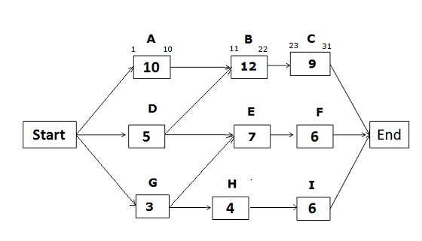
Early Start and Early Finish Dates for the path Start -> A -> B -> C -> End

Slide 13
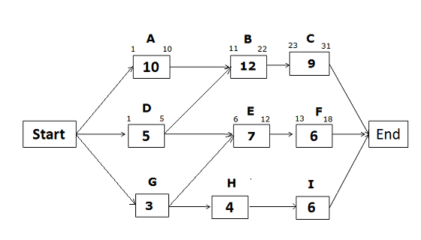
Early Start and Early Finish Dates for the path Start -> D -> E -> F -> End

Slide 14
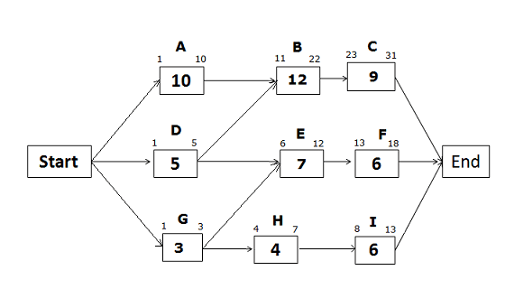
Early Start and Early Finish Dates for the path Start -> G -> H -> I -> End

Slide 15
Calculating Late Start (LS) and Late Finish (LF)
The formula used for Late Start and Late Finish dates:
Late Start of Activity = Late Finish of activity – activity duration + 1
Late Finish of Activity = Late Start of successor activity – 1

Slide 16
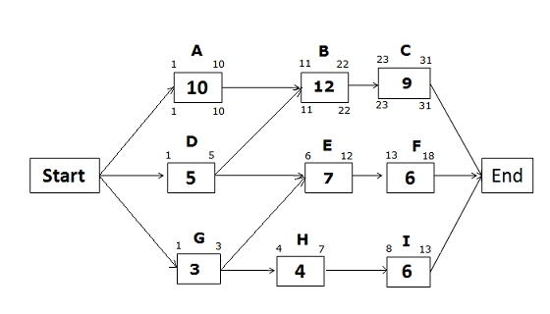
Late Start and Late Finish Dates for the path Start -> A -> B -> C -> End

Slide 17

Late Start and Late Finish Dates for the path Start -> D -> E -> F -> End

Slide 18
Contd..
Late Finish of activity F = 31 (because you cannot allow any activity to pass the project completion date)
Late Start of activity F = LF of activity F – activity duration + 1 = 31 – 6 +1 = 26
Late Finish of Activity E = LS of successor activity – 1 = LS of Activity F – 1 = 26 – 1 = 25
Late Start of Activity E = LF of activity E – activity duration + 1 = 25 – 7 + 1 = 19

Slide 19
Contd..
Late Finish of activity D = LS of successor activity – 1
If you look at the network diagram, you will notice that activity D has two successor activities, B and E. So, which activity would you select?
You will select the activity with the earlier (least) Late Start date. Here, the Late Start of activity B is 11, and the Late Start of activity E is 19.
Therefore, you will select activity B, which has the earlier Late Start date.
Hence,
Late Finish of activity D = LS of activity B – 1 = 11 – 1 = 10
Late Start of Activity D = LF of activity D – activity duration + 1 = 10 – 5 + 1 = 6

Slide 20
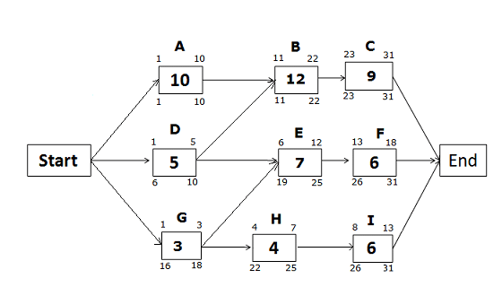
Late Start and Late Finish Dates for the path Start -> G -> H -> I -> End

Slide 21
Contd..
Late Finish of activity I = 31 (because you cannot allow any activity to pass the project completion date)
Late Start of activity I = 31 – 6 + 1 = 26
Late Finish of activity H = 26 – 1 = 25
Late Start of activity H = 25 – 4 + 1 = 22
Late Finish of Activity G = 19 – 1= 18 (we will choose the late start of activity E, not activity H because the Late Start of activity E is earlier than the Late Start of activity H).
Late Start of activity G = 18 – 3 + 1= 16

Slide 22
Calculate the Free Float
The formula for the Free Float is:
Free Float = ES of next activity – EF of current activity – 1

Slide 23
Benefits of the Critical Path Method
The following are a few benefits of the Critical Path Method:
It shows a graphical view of the project.
You can discover and visualize dependencies.
It aids in project planning, scheduling, and controlling.
It helps in contingency planning.
You can see the critical path and identifies critical activities.
It helps you assign the float to activities and flexibility to float activities.
It shows you where you can take action to bring projects back on track.

Slide 24
Drawbacks of the Critical Path Method
Although the critical path is a very useful tool in project planning, it has some drawbacks, such as:
The Critical Path Method is an optimal planning tool and assumes that all resources are available for the project at all times.
It does not consider resource dependencies.
There is a chance of misusing float or slack.
Less attention paid to non-critical activities, though sometimes they may become critical activities.
Projects based on the critical path often do not finish on time.

Slide 25
CASE STUDY
Using the information in the Table, assuming that the project team will work a standard working week (5 working days in 1 week) and that all tasks will start as soon as possible:
(i) Determine the critical path of the project.
(ii) Calculate the planned duration of the project in weeks.
(iii) Identify any non-critical tasks.

Slide 26
Contd..
Task | Description | Duration (Working Days) | Predecessor/s
A | Requirement Analysis | 5
B | Systems Design | 15 | A
C | Programming | 25 | B
D | telecoms | 15 | B
E | Hardware Installation | 30 | B
F | Integration | 10 | C, D
G | System Testing | 10 | E, F
H | Training/Support | 5 | G
I | Handover and Go-Live | 5 | H

